Slide 1
Learn Blockchains by Building One

Slide 2
Representing a Blockchain

Slide 3
What does a Block look like
Trans.json

Slide 4
Adding Transactions to a Block
Addtrans.py

Slide 5
Creating new Blocks
Newblock.py

Slide 6
Understanding Proof of Work

Slide 7
A Proof of Work algorithm (PoW) is how new Blocks are created or mined on the blockchain.
The goal of PoW is to discover a number which solves a problem. The number must be difficult to find but easy to verify

Slide 8
Let’s decide that the hash of some integer x multiplied by another y must end in 0. So, hash(x * y) = ac23dc...0. And for this simplified example, let’s fix x = 5.

Slide 9
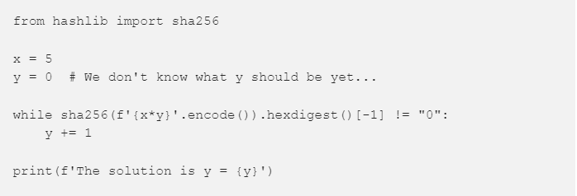

Slide 10
from hashlib import sha256
x = 5
y = 0 # We don't know what y should be yet...while
sha256(f'{x*y}'.encode()).hexdigest()[-1] != "0": y += 1
print(f'The solution is y = {y}‘)
REFER hashcash.py

Slide 11
Our Blockchain as an API
/transactions/new post request
to create a new transaction to a block
/mine get request
to tell our server to mine a new block.
/chain
to return the full Blockchain.

Slide 12
Interacting with our Blockchain
Let’s try mining a block by making a GET request to http://localhost:5000/mine
Let’s create a new transaction by making a POST request to
http://localhost:5000/transactions/new with a body containing our transaction structure:

